Slide 1

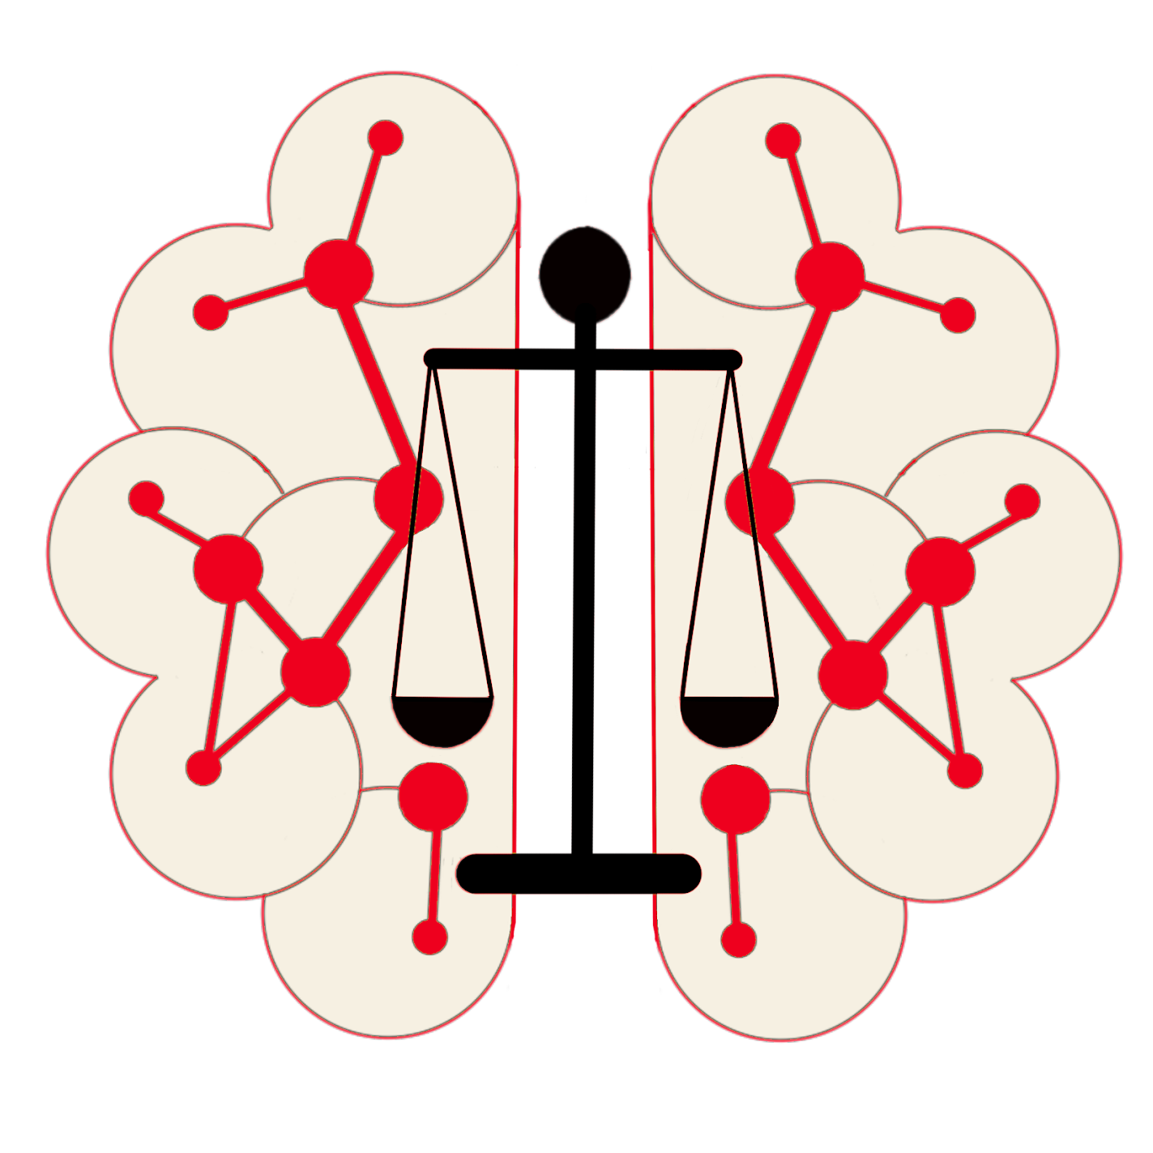
Search as a Service
Design Specification
SEMANTIC
Governance
This presentation outlines a comprehensive design specification for Search as a Service, covering various scenarios from basic search to intelligent assistants. The system incorporates Persona, Location, Party (Organization), Role, and Job To Be Done within the context of Technical, Operational, or Business Services, mapped to Projects or Services.
Notes:
‹#›

Slide 2
Search Scenarios Overview
SEMANTIC
Governance
1
Basic Search
2
Augmented Search
3
Intelligent Search
4
Simulation Search
5
Intelligent Assistant
Notes:
‹#›

Slide 3





SEMANTIC
Governance
Basic Search Features
Keyword Matching
Simple Filtering
Personalized Results
Boolean Logic
Basic Search provides fundamental search capabilities, including keyword matching, boolean logic, simple filtering, and personalized results based on user behavior.
Notes:
‹#›

Slide 4
Augmented Search Capabilities
SEMANTIC
Governance
Complex Logic and Phrase Matching
Basic Analytics
Personalized Analytics Views
This level of search introduces basic analytics capabilities, enabling users to gain insights from their search results.
Analytics views are tailored based on user roles and preferences, providing a more relevant and customized search experience.
Augmented Search supports advanced search techniques, allowing users to construct more sophisticated queries using complex logic and precise phrase matching.
Notes:
‹#›

Slide 5

SEMANTIC
Governance
Key Components: Taxonomies
Persona
Location
Defines different user types and their characteristics, enabling personalized search experiences.
Incorporates geographical and spatial information to provide location-aware search results.
Party (Organization)
Role
Classifies different organizations and entities involved in the search ecosystem.
Defines user roles such as Customer, Provider, and Partner, influencing search permissions and results.
Notes:
‹#›

Slide 6




SEMANTIC
Governance
Key Components: Ontologies
1
Jobs To Be Done
2
Outcomes
3
Services
4
Domain
Ontologies provide a structured representation of knowledge within the search system, defining relationships between different concepts and entities. This hierarchical structure enables more intelligent and context-aware search capabilities.
Notes:
‹#›

Slide 7
Key Components: AI Agents
Conversations are recursive by nature which requires dynamic learning and knowledge curation
SEMANTIC
Governance
Prompt Engineering
Dynamic Generation of Federated Graph Queries
AI agents support the creation and optimization of prompts to improve search accuracy and relevance.
Agents can generate complex graph queries from natural language prompts, enabling more sophisticated search capabilities.
Dynamic Generation of Relational Queries
AI agents translate graph queries into relational queries, bridging the gap between different data structures and search paradigms.
Notes:
‹#›

Slide 8
Domain-specific Knowledge Graphs
SEMANTIC
Governance
Purpose
Benefits
Domain-specific knowledge graphs provide a structured representation of information within a particular field or industry, enhancing the search system's understanding of context and relationships.
Improved search accuracy
Enhanced context awareness
Better support for complex queries
Facilitation of knowledge discovery
Notes:
‹#›

Slide 9
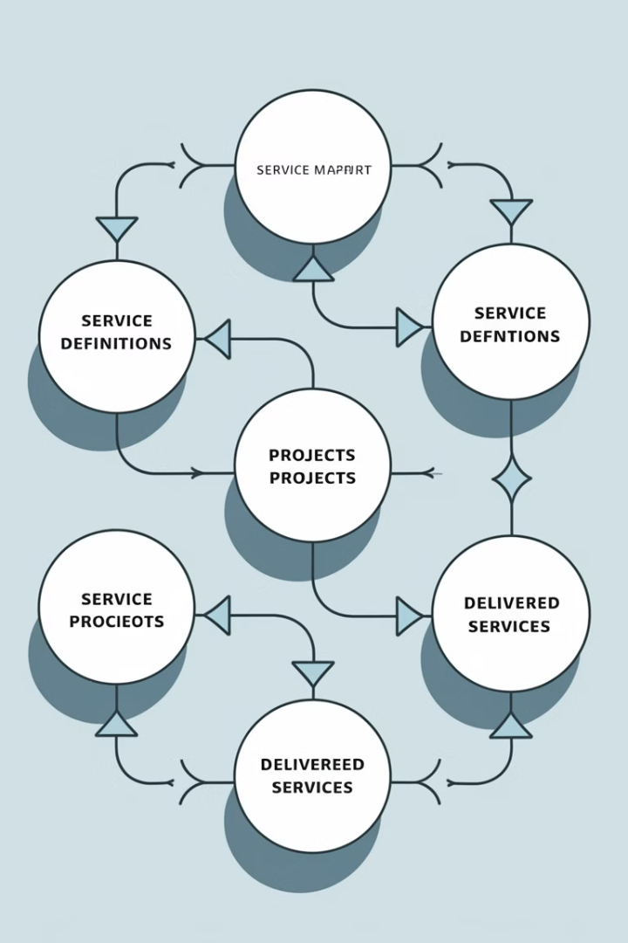



Service Mapping
SEMANTIC
Governance
Service Definition
Define the service within the context of Technical, Operational, or Business categories.
Project Mapping
Map the service to a project that is currently being built or developed.
Service Delivery
Map the service to an existing service that is being delivered to users or customers.
Notes:
‹#›

Slide 10





SEMANTIC
Governance
Search Context Integration
User Context
Organizational Context
Incorporates user-specific information such as preferences, history, and behavior.
Considers the user's role within their organization and relevant business processes.
Goal-oriented Context
Environmental Context
Aligns search results with the user's specific goals and objectives.
Takes into account external factors such as location, time, and industry trends.
Notes:
‹#›

Slide 11
System Architecture Overview
SEMANTIC
Governance
Presentation Layer
UX (APIs)
Taxonomies
App / Logic Layer
(Search Services, AI Agents, BI Agents)
Search Query
Search Pre - Processor
Ontologies
Inferencing
(AI Agents)
Results
personalized
Relevant
Precise
Semantic Knowledge Layer
(Taxonomies, Ontologies, Graphs)
Integration Layer
(Data, BI, AI, Semantic Services)
Federated Graph Query
Persistence Layer
(GraphDB, Relational DBs, Non-Relational DBs)
Core Components
Data Flow
The system architecture integrates various components including search engines, AI agents, knowledge graphs, and user interfaces to provide a comprehensive Search as a Service solution.
The architecture ensures efficient data flow from ingestion and processing to retrieval and presentation, enabling fast and accurate search results across all search scenarios.
Notes:
‹#›

Slide 12
System Design Components
SEMANTIC
Governance
Taxonomies
Search Pre-Processor
Personalization - captured during login. used to frame the context around WHAT is relevant to the individual using a Unified Persona Model. The UPM is more than attributes and prior experiences. This is a rich fabric of graphs about a Job Executor, Jobs they perform, the Desired Outcomes they want to achieve with the processes / services / systems they interact with when they perform each job.
Contextual Relevancy - captured from the prompt (input field and/or handoff from AI Prompt. This is preparatory towards conversational interaction.
  Reverse engineer the words & phrases from the prompt and map to the services and/or process(es) within a given domain so we can identify relevant context for selection.
  Identify relevant data sources for downstream query via orchestration (TBD) to generate output for consumer.
Search Query
Search Pre - Processor
Ontologies
Inferencing
(AI Agents)
Results
personalized
Relevant
Precise
Federated Graph Query
Notes:
‹#›

Slide 13
System Design Components
SEMANTIC
Governance
Taxonomies
Federated Graph Query
Contextual Framing - Generate multiple SPARQL queries with SHACL (constraints) to navigate to the appropriate graphs (domain-specific graphs >> mapping graphs >> RDB graphs)* to generate a list of nodes, relations, attributes, and Content sources (digital assets).
  Need the ability to map words & phrases directly (match using primary labels and/or alternate labels in our taxonomies)
  Need the ability to traverse taxonomies and derive lineage to one or more ontologies and the relevant (filtered list) of mapping graphs down to the Content sources.
  Leverage Metaphactory to convert context inputs (from above) to generate SPARQL queries against the knowledge fabric (scaffold of graphs).
  Generate list of entities, conditional logic, & constraints for downstream consumption for querying sources.
Search Query
Search Pre - Processor
Ontologies
Inferencing
(AI Agents)
Results
personalized
Relevant
Precise
Federated Graph Query
* See next slide for overview of Knowledge Fabric design
Notes:
‹#›

Slide 14
Knowledge Fabric
Inference Engine (Graph LLM)
SEMANTIC
Governance
GraphDB
Named Graphs
Named Graphs
Named Graphs
Named Graphs
Ontology
Network Domain
Build KG with Sample Data
✅
Demo
(Visual + SPARQL)
KG
(Context + Content)
RAN (RDB Snapshot) 1:1
RAN (Schema + Data)
(Transient)
Ontology
Network Domain
Wireless
R2R Mapping
Ontology Classes
2
RDF Structure
RDF Structure
Ontology for
RDB Snapshot
(Autogenerated)
✅
1:1
1:1
Incremental Build Plan for Knowledge Fabric:
Create RDF Structure RAN RDB
Map RDF to RDB structure (visual)
Generate R2RML script (manual)
Build KG using Mappings & Sample Data
Build Search App
1:1
IRI Mappings
RAN DB Classes to:
(1) Schema Instances
(2) Data Instances
Postgres
(Data)
✅
Build KG with Sample Data for validating each Knowledge Extension

Slide 15
System Design Components
SEMANTIC
Governance
Taxonomies
Inferencing (AI Agents)
Precision Results - Introducing SLMs (small language models) that are domain specific aligns with the component model used to build out the Knowledge Fabric (taxonomies, ontologies, mapping graphs, and RDB graphs)*.
  The SLMs are part of a larger agentic design pattern that supports parallel inferencing across graphs to arrive at an optimize result.
  These agents will need to collaborate on the separate domain-specific queries using the prompt input for Search to harmonize and consolidate the outputs into a concise set of results that can be presented for downstream orchestration (extract, transform, analyze, and perhaps visualize) to meet the desired outcomes of the Search customer.
  Initial rollout will be using a single AI agent built using a graph LLM to generate the result sets for querying GCP.
Search Query
Search Pre - Processor
Ontologies
Inferencing
(AI Agents)
Results
personalized
Relevant
Precise
Federated Graph Query
* See prior slide for overview of Knowledge Fabric design
Notes:
‹#›

Slide 16
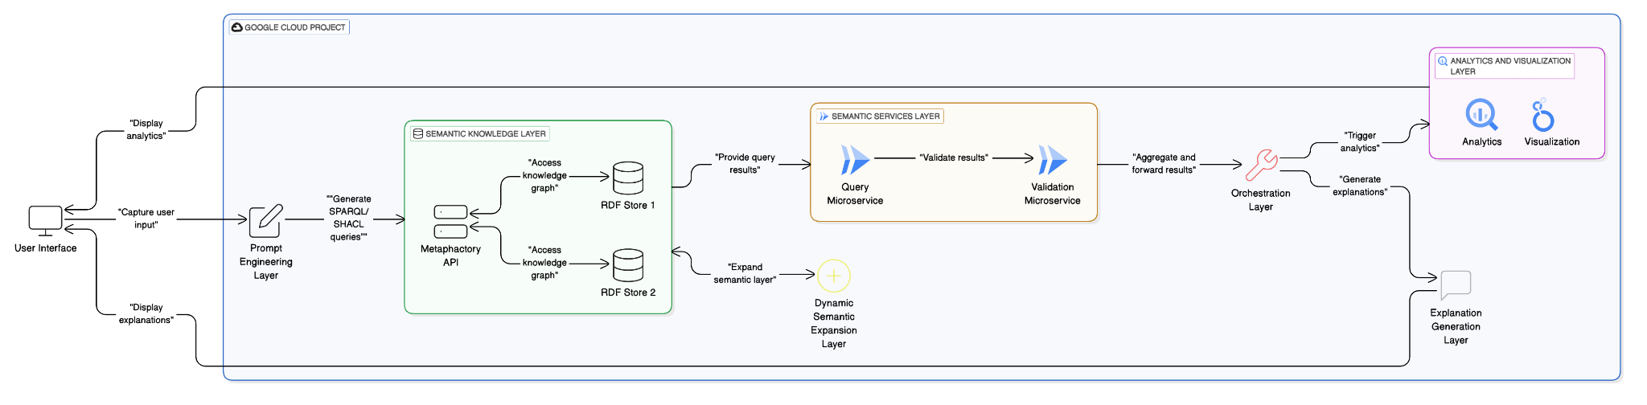
Solution Design
SEMANTIC
Governance
Inferencing (AI Agents)
The above diagram is a simplified End-2-End Flow showing where the Semantic Services will be deployed. The flow shows two sets of semantic services:
  Search & Discover
  Knowledge Expansion
The flow touches on some of the downstream orchestration
  Data services (extract, transform, load, map, merge)
  BI services (aggregation, metrics, trending, analysis, insights, visualization)
  AI services (inferencing, summarizing, projection, generate, explain)
Notes:
‹#›

Slide 17
Solution Design
SEMANTIC
Governance
Key Components
Prompt Engineering - Captures user inputs (words, phrases, and questions) and translates them into structured queries.
Semantic Knowledge - Utilizes consumer persona models and inputs to generate SPARQL and SHACL queries for knowledge graph access.
Semantic Services - A set of microservices that interact with Metaphactory APIs to query RDF stores and generate outputs for downstream processing.
Orchestration - Applies conditional logic and constraints to guide downstream microservices, BI agents, and AI agents.
Analytics and Visualization - Extracts, transforms, and applies analytics and visualizations to the data.
Explanation Generation - Generates contextual explanations for the results.
Dynamic Semantic Expansion - Expands the semantic knowledge layer with enterprise and domain-specific contexts.
Notes:
‹#›

Slide 18
Solution Design
SEMANTIC
Governance
Key Components (Functional Breakdown)
Prompt Engineering
  Capture user inputs (words, phrases, and questions) via a natural language interface.
    Parse and normalize inputs to generate structured queries.
    Map user inputs to consumer persona models for contextual relevance.
Semantic Knowledge
  Use consumer persona models to contextualize queries.
  Generate SPARQL queries to retrieve data from RDF stores.
  Use SHACL to validate and constrain query results based on business rules.
  Integrate with Metaphactory APIs to access knowledge graphs.
Semantic Services
  Provide microservices to:
    Query RDF stores using SPARQL.
    Validate and constrain results using SHACL.
    Dynamically expand the semantic knowledge layer with enterprise and domain-specific contexts.
  Expose APIs for downstream services to consume query results.
Orchestration
  Apply conditional logic and constraints to guide downstream microservices, BI agents, and AI agents.
  Ensure seamless integration between semantic services and downstream processing.
Analytics and Visualization
  Extract and transform data from query results.
    Apply analytics to generate insights.
    Create visualizations (e.g., charts, graphs, dashboards) for presentation.
Explanation Generation
  Generate natural language explanations for query results.
  Provide contextual insights based on consumer persona models.
Dynamic Semantic Expansion
  Dynamically expand the semantic knowledge layer with:
  Enterprise context (vocabularies, taxonomies, and ontologies).
  Domain-specific context (vocabularies, taxonomies, and ontologies).
  Ensure the system adapts to evolving business and domain requirements.
Notes:
‹#›

Slide 19
SEMANTIC
Governance
Semantic Search Pilot (Goals)
Goals for enabling phase 1 Semantic Search
Define, Design, and Deliver initial set of Semantic Services (microservices to wrapper API calls to Metaphactory)
  leverage their federated graph query APIs as an accelerator
Showcase Unified Persona Model to refine and optimize Search Relevancy
Demonstrate simplified UX by implementing a backplane of Semantic Services
Generate a set of federated queries for digital assets
  assume these assets will be stored in GCP
  assume Semantic Services will deliver a set of queries to Orchestration Engine
  Note: EA has defined a direction for an Orchestration Engine (TBD)
Notes:
‹#›

Slide 20
SEMANTIC
Governance
Semantic Search Pilot (Scope)
Scope for initial pilot:
Leverage Semantic Pilot work
  Search will focus on one Data Product (TBD), which we have setup for basic search of concepts in Metaphactory
    Note: We may want to focus on some new Data Products which have significant visibility
    If we introduce new Data Products, then the Knowledge Engineering team may need to build / extend Domain Ontologies
  Currently, we do not have a centralized location for Persona data. We may want to bootstrap a simple schema in Postgres (in our DEV environment for Metaphactory)
    We will need to source Persona data from existing systems and available materials (docs, etc.)
    We will need a design to support scale for capturing and warehousing Persona data in advance of launch
  Basic Search will consist of a few scenarios:
    Token Based Search (select list of data elements) - may or may not match business terms in the Catalog or GCP Columns
    Marketplace Search using InfoVision (natural language)
  Both scenarios will facilitate handoffs to Semantic Services through Marketplace and VDIL
Downstream orchestration can be introduced in Phase 2
Notes:
‹#›

Slide 21
Capability Heat Map
Items in RED are priority one
SEMANTIC
Governance
Functional Areas
Product
Management
Customer
Relationship
Network Operations
Supply Chain &
Distribution
Business
Administration
Category/Brand
Strategy
Customer Relationship Strategy
Network Architecture
Supply Chain Strategy
Corporate Strategy
Capacity Planning
Corporate Planning
Plan
Category/Brand
Planning
Customer Relationship Planning
Supply Chain Planning
Alliance Management
Project Planning &
Field Services
Line of Business Planning
Brand P&L
Management
Assessing Customer Satisfaction
Distribution Oversight
Business Performance Management
Matching Supply
and Demand
Customer Insights
Wireless Service Delivery
(Includes FWA)
External Market
Analysis
Manage
In-bound Logistics
Out-bound Logistics
Marketing Development & Effectiveness
Organization and Process Design
Component Service Categories
Account Management
Supplier Control
Legal and Regulatory Compliance
Product Ideation
Concept/Product Testing
Wireline Service Delivery
Treasury and Risk Management
Value-Added Services
Distribution Center Operations
Accounting and GL
Product Development
Customer Account Servicing
Customer Support
Execute
Product Management
Indirect Procurement
Retail Marketing Execution
Inventory Management
Transportation Resources
Facilities and Equipment Management
Marketing Execution
Consumer Service
Device Management
Procurement
HR Administration
Customer Directory
En route Inventory Management
IT Systems and Operations
Product Directory
Legend: Capability Heat Map
No Priority
Tier One
Tier Two
Tier Three

Slide 22
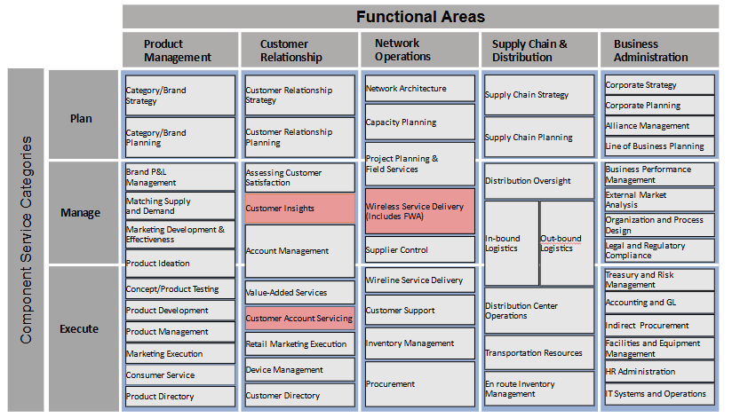
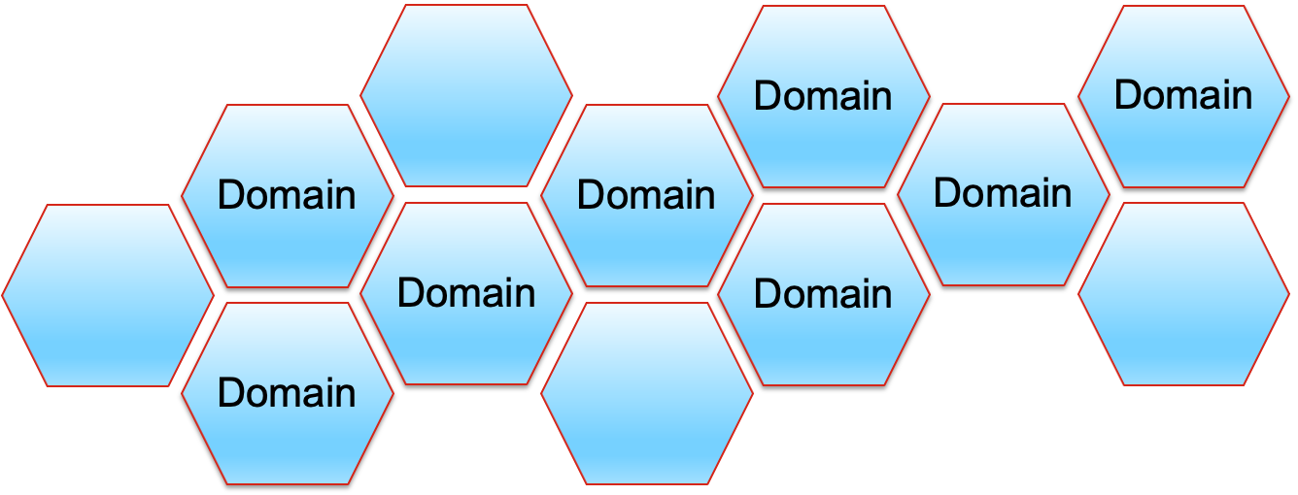
Semantic Search (Scope)
SEMANTIC
Governance
Domains
Commercial Operations
Retail Sales
Sales Operations
Marketing Operations
Corporate Operations
Contract Management
Real Estate
Energy & Power Management
Network Operations
Wireless Services
Wireline Services
Customer Support
Notes:
‹#›

Slide 23
Success Criteria
SEMANTIC
Governance
Semantic Search (Needs)
Success Criteria for enabling phase 1 Semantic Search
Scenario 1:
  Persona: Data Engineer in Marketing (SOW)
  Scenario A: Searching for table name where upgrades for Perks were added
  Scenario B: Can someone explain what VZW-EROES' channel ID means?
  Outcomes:
Scenario 2:
  Persona: Data Scientist in Sales
  Scenario A: Search for tables where device returns are captured in device payment plan (DPPs)
  Scenario B: Search for reasons why someone previously upgraded through a DPP loan and also has a contract
  Scenario C: Are there any tables that store the the actual Content of the communication (text/ emails) for Wireline customers
  Outcomes:
Success Criteria for enabling phase 1 Semantic Search
Scenario 3:
  Persona: BI Analyst in Customer Experience
  Scenario A: Find the list of tables that power the FWA dashboard:
  Outcomes:
Scenario 4
  Persona: Sr Analyst in CS Strategy, Experience
  Scenario A: Find a table / logic / or PoC for credit risk assessment. IE what factors are used to determine a customer’s credit risk CD
  Outcomes:
Scenario 5:
  Persona: BI Analyst in Marketing
  Scenario A: Find table(s) with Fios Voice Agent Assistant data
  Scenario B: Find an indicator to determine if a CUST_ID / ACCT_NUM is within the FiOS footprint
  Outcomes:
Note: These are just a sample pulled from vz-data-discovery Slack Channel
Notes:
‹#›

Slide 24
SEMANTIC
Governance
Semantic Search (Needs + Outcomes)
Success Criteria for enabling phase 1 Semantic Search
Scenario 1:
  Persona: Data Engineer in Marketing (SOW)
  Scenario A: Searching for table name where upgrades for Perks were added
Outcomes
  Reduce the effort to identify the correct table
  “I want to locate the specific table containing Perks upgrade data quickly, without having to sift through irrelevant tables or complex database structures.”
  Increase the likelihood that I have clarity on the data structure and relationships
  “I need to understand how the Perks upgrade data is structured, including key columns, relationships with other tables, and data lineage to ensure accurate data integration.”
  Increase the likelihood that having confidence in (1) Data Accuracy and (2) Currency
  “I want to verify that the table contains the most up-to-date and accurate information on Perks upgrades to support reliable marketing insights and campaigns.”
  Increase the likelihood that the table can be seamlessly integrated into existing marketing analytics
  “I need the table to be easily accessible and compatible with our existing data pipelines so I can quickly incorporate Perks upgrade data into marketing reports and dashboards.”
  Reduce the effort for troubleshooting data discrepancies
  “I want to trace any data issues related to Perks upgrades back to the source table efficiently, enabling fast resolution of discrepancies in marketing analyses.”
Notes:
‹#›

Slide 25
SEMANTIC
Governance
Semantic Search (Needs + Outcomes)
Success Criteria for enabling phase 1 Semantic Search
Scenario 1:
  Persona: Data Engineer in Marketing (SOW)
  Scenario B: Can someone explain what VZW-EROES' channel ID means?
Outcomes
  Increase the likelihood of getting a clear and accurate definition of the acronym
  “I want to quickly find a clear, accurate definition of what VZW-EROES stands for, so I can understand its relevance to my data analysis.”
  Increase the likelihood of understanding the context and purpose of the Channel ID
  “I need to know the business context and purpose of the VZW-EROES channel ID to understand how it fits within marketing campaigns, customer journeys, or operational processes.”
  Increase the likelihood of obtaining insight into relationships and dependencies of data associated with this channel ID
  “I want to identify how the VZW-EROES channel ID connects to other data points, such as customer segments, products, or campaign channels, to ensure accurate data mapping.”
  Reduce the likelihood of feeling anxious about source and validity of the explanation
  “I need to ensure that the explanation of VZW-EROES comes from a reliable, authoritative source so I can trust the information in my data workflows.”
  Reduce the effort required to retrieve and apply the information
  “I want to access the meaning of VZW-EROES quickly, without navigating through multiple systems, so I can focus on integrating this understanding into my marketing analytics tasks.”
Notes:
‹#›

Slide 26
SEMANTIC
Governance
Semantic Search (Needs + Outcomes)
Success Criteria for enabling phase 1 Semantic Search
Scenario 2:
  Persona: Data Scientist in Sales
  Scenario A: Search for tables where device returns are captured in device payment plan (DPPs)
Outcomes
  Reduce the effort & time required to discover relevant tables
  “I want to quickly identify all tables that capture device return data related to DPPs, minimizing time spent navigating complex data ecosystems.”
  Increase the likelihood of obtaining a comprehensive understanding of data coverage for device returns in DPPs
  “I need to ensure that the tables I find cover all relevant device return scenarios within DPPs, including partial returns, exchanges, and early upgrades, to support robust analysis.”
  Increase the likelihood of obtaining insight into relationships and dependencies of data associated with device returns
  “I want to understand how the device return data in DPP tables links to other datasets, such as customer accounts, payment histories, and sales transactions, to create accurate analytical models.”
  Reduce the likelihood of feeling anxious about the accuracy and/or timeliness of the data
  “I need assurance that the data in the identified tables is accurate, up-to-date, and reflects the current business processes around DPPs and device returns.”
  Reduce the effort required to integrate the device returns data into existing sales analytics
  “I want the device return data to be in a format that allows for seamless integration into my predictive models and sales performance dashboards, enhancing insights into return trends and their impact on revenue.”
Notes:
‹#›

Slide 27
SEMANTIC
Governance
Semantic Search (Needs + Outcomes)
Success Criteria for enabling phase 1 Semantic Search
Scenario 2:
  Persona: Data Scientist in Sales
  Scenario B: Search for reasons why someone previously upgraded through a DPP loan and also has a contract
Outcomes
  Increase the likelihood of accurately identifying customer upgrade patterns
  “I want to accurately identify customers who have both upgraded through a DPP loan and maintain a contract, so I can analyze their behavior without missing key segments.”
  Increase the likelihood of clearly understanding the underlying business drivers
  “I need to uncover the business or policy reasons behind customers having both a DPP loan and a contract, such as promotional offers, retention strategies, or device upgrade programs, to inform sales tactics.”
  Increase the likelihood of obtaining insight about customer decision-making factors
  “I want to understand the factors influencing customer decisions to maintain both a DPP loan and a contract, such as financial incentives, device preferences, or service bundling, to enhance predictive models.”
  Increase the likelihood of being able to correlate this data with sales and churn metrics
  “I need to correlate this dual engagement (DPP + contract) with sales performance, churn rates, and customer lifetime value, to assess its impact on revenue and retention strategies.”
  Increase the ability to incorporate this data into sales optimization strategies
  “I want to generate actionable insights from the data that can be used to refine sales strategies, personalize customer offers, and identify opportunities to upsell or cross-sell effectively.”
Notes:
‹#›

Slide 28
SEMANTIC
Governance
Semantic Search (Needs + Outcomes)
Success Criteria for enabling phase 1 Semantic Search
Scenario 2:
  Persona: Data Scientist in Sales
  Scenario C: Are there any tables that store the the actual Content of the communication (text/ emails) for Wireline customers
Outcomes
  Increase the likelihood of efficiently finding and discovering the right (relevant) data sources
  “I want to quickly identify all tables that store the actual content of Wireline customer communications, so I can reduce the time spent on data exploration and focus on analysis.”
  Increase the likelihood of obtaining comprehensive access to communication data
  “I need to ensure that I’m accessing all relevant communication data (across emails, texts, and other channels) so my analysis captures the full customer interaction landscape.”
  Increase the likelihood of clarifying the data structure and schema
  “I want to understand the schema, metadata, and relationships of the identified tables, so I can efficiently query, process, and integrate the data with other customer datasets.”
  Increase the ability to derive insights for sales optimization
  “I need to analyze the content of customer communications to uncover patterns, sentiment, and preferences that can drive personalized sales strategies and improve customer engagement.”
  Increase the likelihood that the data is compliant with data privacy and security standards
  “I want to ensure that any analysis of communication content adheres to data privacy regulations and internal security policies, so sensitive customer information is handled responsibly.”
Notes:
‹#›

Slide 29
SEMANTIC
Governance
Semantic Search (Needs + Outcomes)
Success Criteria for enabling phase 1 Semantic Search
Scenario 3:
  Persona: BI Analyst in Customer Experience
  Scenario A: Find the list of tables that power the FWA dashboard
Outcomes
  Reduce the effort and time required to identify a list of data sources
  “I want to quickly identify all tables that feed into the Fixed Wireless Access dashboard, so I can minimize time spent on data discovery and focus on analyzing customer experience metrics.”
  Increase the likelihood of understanding data lineage and any dependencies with the data
  “I need to understand how data flows from source tables to the dashboard, including transformations and dependencies, so I can ensure data accuracy and troubleshoot issues effectively.”
  Increase the likelihood of obtaining data that has been validated with good data quality and is consistent
  “I want to verify that the data powering the dashboard is consistent, complete, and accurate, so I can trust the insights derived and make confident recommendations to improve customer experience.”
  Increase the likelihood of improving the performance and optimization of dashboards
  “I need to identify performance bottlenecks in the data sources to optimize query efficiency and dashboard responsiveness, ensuring a seamless experience for stakeholders.”
  Increase the likelihood of enhancing my ability to customize the insights for wireline data
  “I want to understand the underlying data structure so I can create customized reports or add new metrics to the dashboard, aligning insights more closely with evolving business needs.”
Notes:
‹#›

Slide 30
SEMANTIC
Governance
Semantic Search (Needs + Outcomes)
Success Criteria for enabling phase 1 Semantic Search
Scenario 4:
  Persona: Sr Analyst in CS Strategy, Experience
  Scenario A: Find a table / logic / or PoC for credit risk assessment. IE what factors are used to determine a customer’s credit risk CD
Outcomes
  Increase the likelihood of clearly identifying credit risk factors
  “I want to quickly identify the specific tables and data points that capture the factors used in credit risk assessments, so I can understand what drives customer risk profiles.”
  Increase the likelihood of improving visibility into risk assessment logic and models
  “I need to access the logic, algorithms, or PoC models behind credit risk calculations, so I can evaluate how different factors are weighted and how risk scores are derived.”
  Increase the ability to analyze the impact on customer experience
  “I want to analyze how credit risk assessments influence customer journeys and decision points, so I can recommend strategies that balance risk management with a positive customer experience.”
  Increase the likelihood of obtaining insights into historical risk trends
  “I need to explore historical credit risk data to identify trends and patterns, enabling me to predict potential risks and support proactive strategy development.”
  Increase the ability to support data-driven decision making
  “I want to leverage credit risk assessment data to inform strategic decisions, such as refining eligibility criteria for offers or adjusting risk thresholds to optimize business outcomes.”
Notes:
‹#›

Slide 31
SEMANTIC
Governance
Semantic Search (Needs + Outcomes)
Success Criteria for enabling phase 1 Semantic Search
Scenario 5:
  Persona: BI Analyst in Marketing
  Scenario A: Find table(s) with Fios Voice Agent Assistant data
Outcomes
  Increase the likelihood of quickly discovering relevant data tables
  “I want to easily identify the specific tables that contain Fios Voice Agent Assistant data, so I can reduce time spent searching and focus on data analysis.”
  Increase the likelihood of having access to comprehensive interaction data
  “I need to find tables that capture detailed customer interactions with the Fios Voice Agent Assistant, so I can analyze patterns in usage, queries, and customer engagement.”
  Increase the ability to link voice assistant data with marketing metrics
  “I want to connect Voice Agent Assistant data with existing marketing performance metrics, so I can measure its impact on customer acquisition, retention, and satisfaction.”
  Increase the likelihood of obtaining insights into customer behavior and preferences
  “I need data that helps me understand how customers interact with the Voice Agent Assistant, so I can uncover insights about customer needs, preferences, and common issues.”
  Increase the likelihood of obtaining support for data-driven campaign strategies
  “I want to leverage Fios Voice Agent Assistant data to inform marketing strategies, so I can create targeted campaigns that address customer pain points and improve engagement.”
Notes:
‹#›

Slide 32
SEMANTIC
Governance
Semantic Search (Needs + Outcomes)
Success Criteria for enabling phase 1 Semantic Search
Scenario 5:
  Persona: BI Analyst in Marketing
  Scenario A: Find table(s) with Fios Voice Agent Assistant data
Outcomes
  Increase the likelihood of accurately identifying FiOS-eligible customers
  “I want to quickly identify whether a specific CUST_ID or ACCT_NUM falls within the FiOS service footprint, so I can target the right customers for FiOS-specific marketing campaigns.”
  Increase the likelihood of seamlessly integrating with marketing data
  “I need an indicator that can be easily integrated into existing marketing databases and dashboards, so I can streamline segmentation and campaign automation without additional data wrangling.”
  Increase the likelihood of supporting Real-Time or near Real-Time availability and accessibility
  “I want to access up-to-date information on FiOS footprint eligibility, so I can ensure marketing decisions are based on the latest service availability data.”
  Increase the ability to support key marketing campaigns
  “I need precise FiOS footprint data to create personalized marketing strategies, so I can improve conversion rates by focusing on customers who are actually eligible for FiOS services.”
  Increase the likelihood of enhancing reporting and analytics
  “I want to incorporate FiOS footprint indicators into performance reports, so I can analyze the effectiveness of FiOS-specific campaigns and identify growth opportunities within the eligible customer base.”
Notes:
‹#›

Slide 33
SEMANTIC
Governance
Future State Capabilities...
Notes:
‹#›

Slide 34

Intelligent Search Features
SEMANTIC
Governance
Multi-dimensional Analytics
Causal Analysis
This feature enables users to identify and understand cause-and-effect relationships within their data.
Intelligent Search offers advanced analytics capabilities, allowing users to analyze data across multiple dimensions simultaneously.
Trend Forecasting
AI-powered Insights
Intelligent Search incorporates predictive analytics to forecast future trends based on historical data and patterns.
The system leverages artificial intelligence to provide personalized insights based on individual goals and user context.
Notes:
‹#›

Slide 35




Simulation Search Capabilities
SEMANTIC
Governance
Simulate Outcomes
Users can simulate potential outcomes based on user-defined scenarios, allowing for better decision-making and planning.
Model "What-if" Scenarios
The system enables users to create and explore various "what-if" scenarios, testing different hypotheses and strategies.
Highlight Relevant Simulations
Based on past actions and user history, the system suggests and highlights relevant simulations that may be of interest or value to the user.
Notes:
‹#›

Slide 36

SEMANTIC
Governance
Intelligent Assistant Features
1
Natural Language Processing
The Intelligent Assistant utilizes advanced NLP techniques to enable conversational search, allowing users to interact with the system using natural language queries.
2
Real-time Decision Support
By analyzing user queries and context, the assistant provides real-time decision support, offering relevant information and suggestions to aid in decision-making processes.
3
Personalized Recommendations
The system generates personalized recommendations based on the user's context, search history, and inferred intent, enhancing the overall search experience.
Notes:
‹#›

